Slide 1
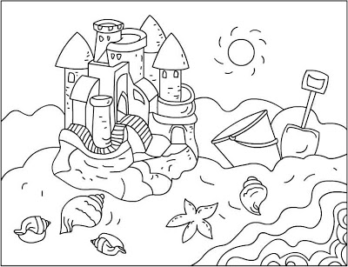
STEAM Sandcastle

Slide 2
FACT:
The tallest and longest sandcastles ever built in the United States of America were constructed at Myrtle Beach, South Carolina.
The longest sandcastle was measured at 10 ½ miles, and the tallest sandcastle was measured at 32 ½ feet.

Slide 3
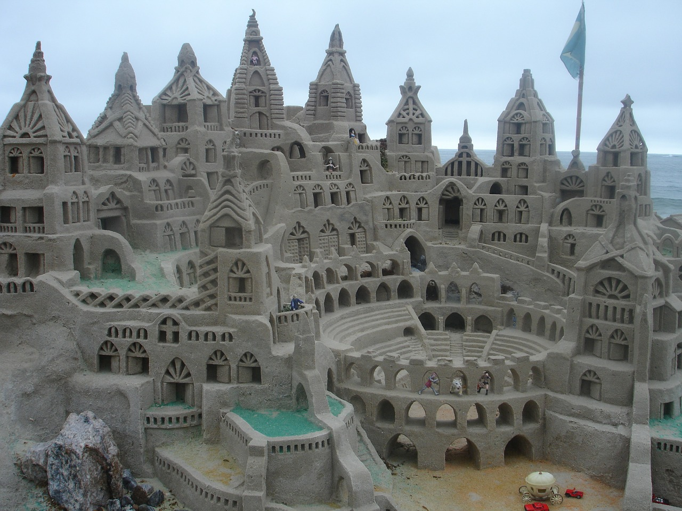
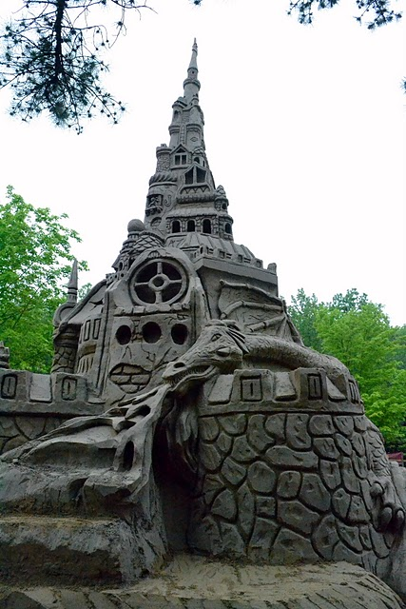
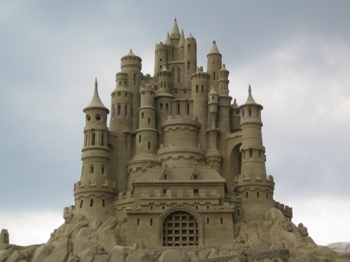
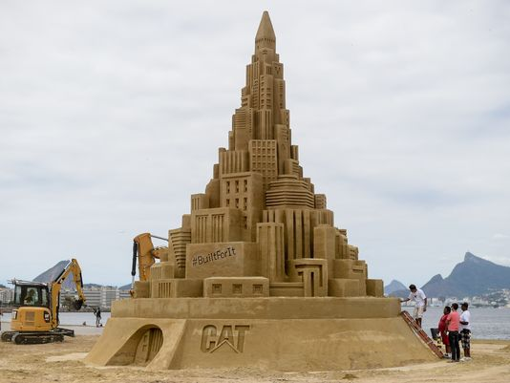

Slide 4
Directions:
Create a place value chart with the longest and tallest sandcastle
Longest: 665,280 in
Tallest: 390 in
Give word form and expanded form of both the longest and tallest sandcastle
For above and beyond:
Research facts about how sandcastles are made.

Slide 5
Add the STEAM
S: we learned a scientific fact about the longest and tallest sandcastle
T: we used technology to look up pictures and facts
E: we engineering a place value chart
A: we created an artistic poster
M: we created a place value chart and gave the word form and expanded form

